Slide 1

Course code Course title Module Topic
: CSE2007
: Database Management System
: 2
: 3
ER-to-Relational Mapping

Slide 2
Objectives
This session will give the knowledge about
ER-to-Relational Mapping

Slide 3
Introduction
The ER Model is convenient for representing an initial high-level database design.
But it does not have details about logical design with all its associated constraints.
Relational model describes design of high-level databased with in-depth logical design with its constrains.
Hence translation of ER Model to Relationship model is necessary

Slide 4
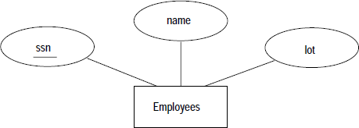
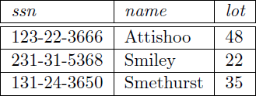
Entity Sets to Tables
CREATE TABLE Employees ( ssn CHAR(11),
name CHAR(30),
lot NUMBER(3),
PRIMARY KEY (ssn) )

Slide 5
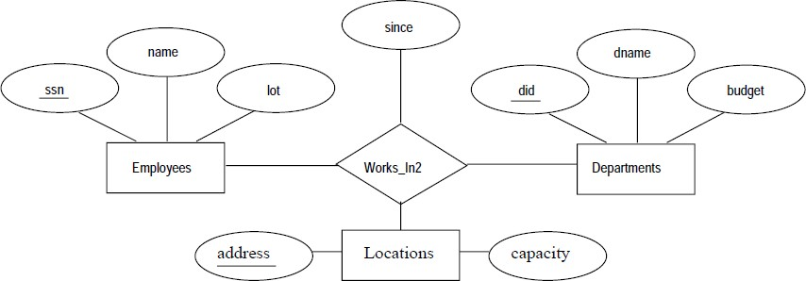
Relationship Sets (without Constraints) to Tables
CREATE TABLE Works_In2 ( ssn CHAR(11), did NUMBER, address CHAR(20), since DATE,
PRIMARY KEY (ssn, did, address),
FOREIGN KEY (ssn) REFERENCES Employees,
FOREIGN KEY (address) REFERENCES Locations,
FOREIGN KEY (did) REFERENCES Departments )

Slide 6
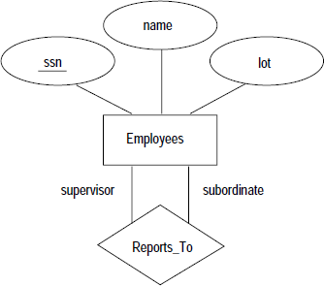
Relationship Sets (without Constraints) to Tables
CREATE TABLE Reports_To ( Supervisor_ssn CHAR(11), Subordinate_ssn CHAR(11),
PRIMARY KEY (supervisor_ssn, subordinate ssn), FOREIGN KEY (supervisor_ssn) REFERENCES
Employees(ssn),
FOREIGN KEY (subordinate ssn) REFERENCES
Employees(ssn) )

Slide 7

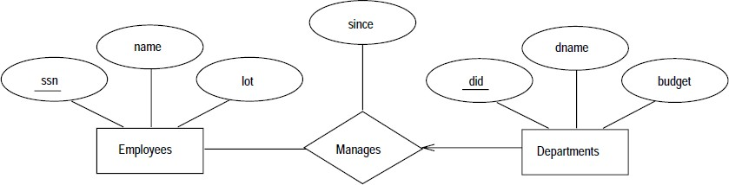
Translating Relationship Sets with Key Constraints
CREATE TABLE Manages ( ssn CHAR(11), did INTEGER, since DATE,
PRIMARY KEY (did),
FOREIGN KEY (ssn) REFERENCES Employees,
FOREIGN KEY (did) REFERENCES Departments )

Slide 8
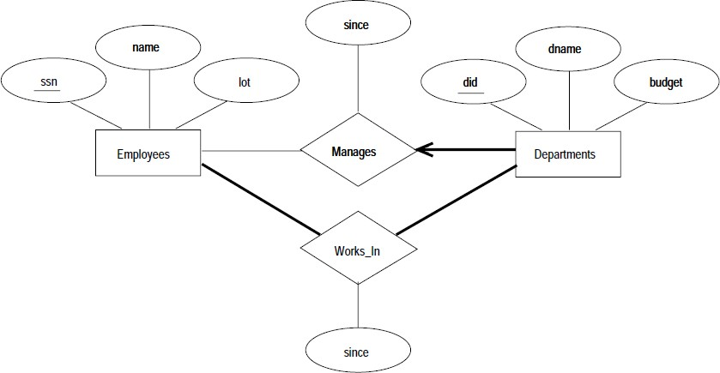
Translating Relationship Sets with Participation Constraints

Slide 9
Translating Relationship Sets with Participation Constraints
CREATE TABLE Dept Mgr ( did NUMBER,
dname VARCHAR2(20),
budget NUMBER(5,2),
ssn VARCHAR2(11) NOT NULL,
since DATE,
PRIMARY KEY (did),
FOREIGN KEY (ssn) REFERENCES Employees
ON DELETE NO ACTION )

Slide 10
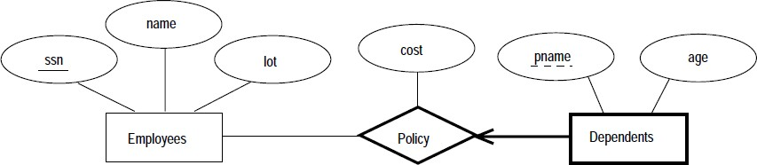
Translating Weak Entity Sets
CREATE TABLE Dep Policy ( pname VARCHAR2(20), age NUMBER, cost NUMBER(5,2),
ssn CHAR(11),
PRIMARY KEY (pname, ssn),
FOREIGN KEY (ssn) REFERENCES Employees
ON DELETE CASCADE )

Slide 11
Summary
This session will give the knowledge about
ER-to-Relational Mapping

